Slide 1
Module 3 Enhanced Security Administrative Forest
Section 3 - Rethinking the Administrative Practices
June 2018

Slide 2
Agenda
01
Think like an attacker It is important to understand how attackers see your network to be able to better protect yourself against them!
05
Securing Privilege Access This is a summary of all protections seen in the course as well as the order you should follow to deploy them.
02
Remote administration tools We are having a closer look at the type of tools you can use to remotely administrate servers
03
Just Enough Administrator Being able to manage a server without being a local admin? It is possible via PowerShell and it is called JeA
04
Windows Admin Center With the deprecation of MMCs, Windows Admin Center is the new go-to tool to manage Windows Server whether they are on-premises, clustered, or in the cloud.

Slide 3
Think graph
The defense team usually sees security as a list of bullet points
Do I have a perimeter firewall? Yes/No
Do I have an antimalware software? Yes/No
I have a service account with privileges, but it is fine because I have a security exemption signed off by some VP which has no idea about the cyber threat landscape…
Attackers see the environment as a graph of dependencies
To access server A, I need identity B which is used on machine C, hence if I can compromise machine C, I can get to server A

Slide 4
.
Video
Video Placeholder
This slide has to be watched with PowerPoint
Notes:
During this video you can see:
A user using Bloodhound to identify the shortest path to a member of a domain admins group

Slide 5
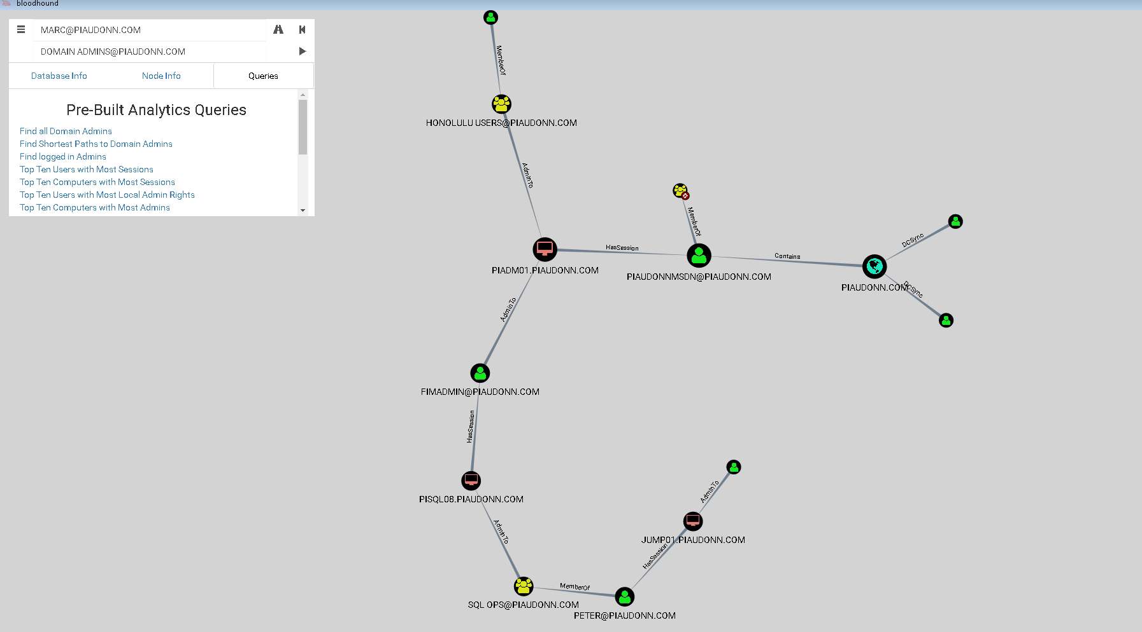
What does the attacker see?
Notes:
The screenshot is from Bloodhound interface.
In this screenshot we can see different suggested paths to compromise the identity of a user who is member of the domain admins group.
Ref: https://github.com/BloodHoundAD/BloodHound

Slide 6

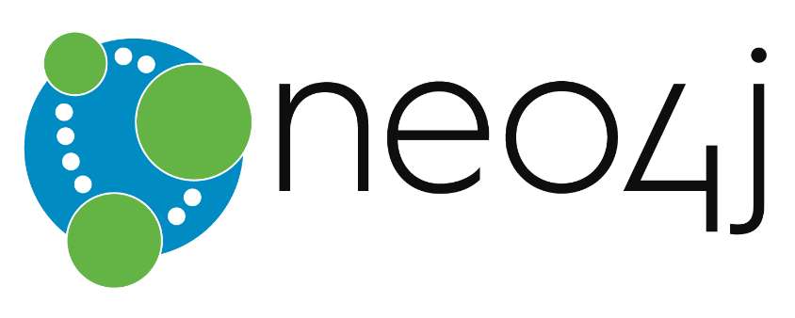
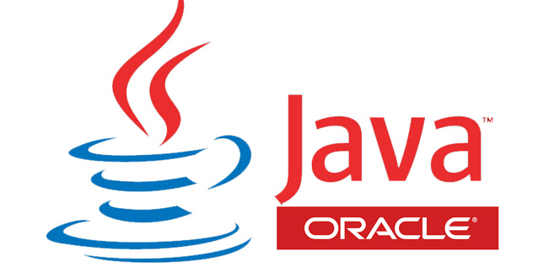
Bloodhound
Open source tool
Uses Neo4J graph database
Requires Java
Collects the data and creates graphs of paths between entities
Can be used by red and blue teams
To identify paths for credential thefts and credentials hygiene issues
To identify paths to secure
Notes:
The collection is using a combination of LDAP queries (for group memberships, AD delegations and GPOs), SMB session enumeration for session detection as well as SMAR-R for local group enumeration. It does not require to be an administrator (any authenticated user can run these reconnaissance actions).
We discussed how to limit these types of reconnaissance in module 2 section 3.

Slide 7
What tools for remote administration?
Remote Server Administration Tools
To be installed on workstations
Administrate Windows Server roles remotely (using RPC)
Tools do not cache the operators’ credential on the administered server
Require having administrative permissions on the role
Remote PowerShell
Requires to be a local admin of the target (or the local Remote Management Users group)
Needs to be enabled on the target
Does not cache the credentials on the target
Uses WinRM
RSAT
Notes:
Note that you do not need to install the RSAT on a server as they are already present in the binaries and just need to be enabled through the Server Manager interface (or its PowerShell equivalent).
Ref: https://support.microsoft.com/en-ca/help/2693643/remote-server-administration-tools-rsat-for-windows-operating-systems

Slide 8
Professor Useful
PowerShell and authentication
There are different ways to authenticate when using Remote PowerShell. One of them is called CredSSP. Although it is practical because it enables the operator to remotely access another machine within a remote session, it has the major issue of sending and caching the credentials of the operator on the remote server.
Do not use (or disable) CredSPP for WinRM
Remote administration needs to be permitted by the Windows Firewall
Notes:
Information about CredSSP: https://msdn.microsoft.com/en-us/library/cc540483.aspx

Slide 9
RDP
What about the remote desktop protocol?
RDP should be the last resort to administrate a server
Default settings will cache the operator’s credential on the server (see module 2 section 3 for mitigations)
What if the server is a core version?
Windows Server Core is a version of Windows Server without a GUI
Connecting using RDP to such a server has little value (there is no desktop)
You can use the built-in firewall to perform network authentication to RDP and WinRM
IPSec security association can be configured on Windows to allow only specific members of AD groups to be authorized to established connections on some network ports (the ones used by RDP and WinRM)
Notes:
We discussed how to secure the RDP connections in module 2 section 3.
Ref: https://docs.microsoft.com/en-us/windows-server/administration/server-core/what-is-server-core

Slide 10
Professor Useful
How to allow network traffic based on AD groups on a server?
Create AD groups and add the computer and user accounts you want to allow
Change the firewall rule for WinRM and RDP from “Allow” to “Allow only if secure” and add the groups you just created in the rules
Create a security association rule which dictates that authentication will be required for the inbound connections of the two ports using Kerberos
On the machines you want to allow traffic from:
Create a security association rule that tries to authenticate when outbound connections are made on the two ports
Notes:
The default ports are :
RDP: TCP/3389
WinRM: TCP/5985

Slide 11
Least Privilege Delegation
Remote administration often requires to be a member of the local administrators group
AD objects delegation does not require any permissions on the DCs, it requires permission only in the directory
Avoid adding accounts in the local administrators group as much as possible, instead, try to tailor the permissions to only the required components of a solution
What if I can’t because a team wants to do something which cannot be delegated?
Notes:
Many network services and applications are designed in such a way that it is sometimes not required to be a member of the local administrators group to be managed. The problem is that an applicative solution often involves different components, some of which require to be a local administrator. Because of this, it is very frequent to see individuals in charge of managing an application by being made a member of the local administrator group to accommodate all administrative scenarios.

Slide 12
JEA
Just Enough Administration
Control precisely what a user is able to do through remote PowerShell
You create a role
You assign a role to users/groups
You whitelist what a role can do
You do not grant the users any permissions on the server!
Things will be done by Jet’s
It’s a role-based access control for remote PowerShell
RBAC
Notes:
JEA is built on the principle of least privilege and provides a RBAC platform through Windows PowerShell.
Allows specific users to perform specific administrative tasks on servers without giving them administrator rights.
Users can perform only those tasks for which they are authorized as part of their role by using Windows PowerShell constrained run spaces.

Slide 13
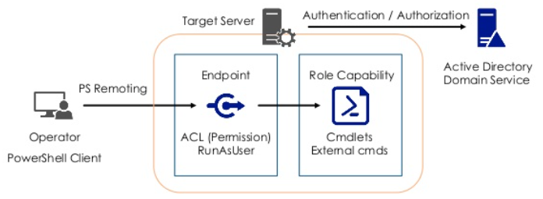
Just Enough Administration
JEA is implemented as a Windows PowerShell session endpoint, which includes:
A PowerShell session configuration file
One or more role capability files
Notes:
PowerShell Session Configuration is a fancy term for PowerShell Endpoint. It is the figurative “place” where users connect and get access to PowerShell functionality. Based on how you set up a Session Configuration, it can provide different functionality to connecting users. For JEA, we use Session Configurations to restrict PowerShell to a limited set of functionality and to “RunAs” a privileged Virtual Account.

Slide 14
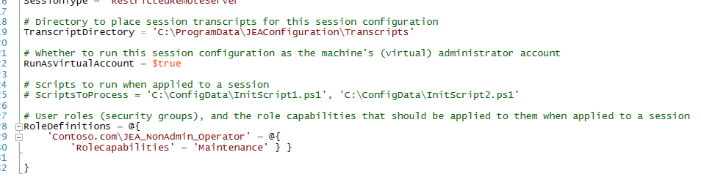
Just Enough Administration
PowerShell Session Configuration File
Lets you specify who can connect to an endpoint
Users and security groups can be mapped to specific management roles
You can also configure global settings such as virtual accounts and logging policies
Files are specific to each machine, so you can control access on a per-machine basis, if you want

Slide 15
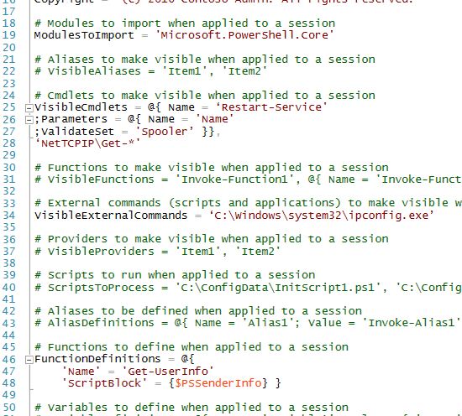
Just Enough Administration
Role Capability Files
Specify what actions users in a particular role can perform
Restrict them to using certain cmdlets, functions, providers, and external programs
Role Capability files are often generic for a particular role (such as DNS admin, tier 1 helpdesk, etc.)
Part of PowerShell modules, and you can easily share them with others
Notes:
Note that you can also create a endpoint with no restriction on which the connected operator will have no restrictions in case you forgot to whitelist something and there is an emergency. But int that case, make sure you enable logging (see later in this section) as well as a workflow to be notified that it is being used (for example using Event Forwarder and/or event triggers to send an email to an audit team).

Slide 16
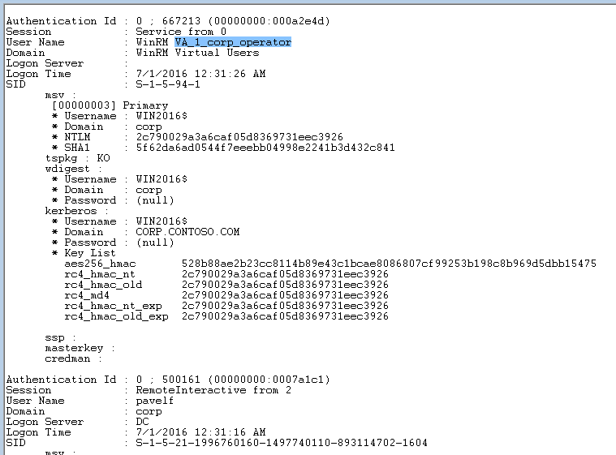
Just Enough Administration
JEA Virtual Accounts
When connecting to an endpoint, a non-administrator “runs as” a privileged “Virtual Account”
The account is local server administrator, domain admin for DCs
JEA virtual account has randomly generated password (127 chars)
Notes:
JEA “Virtual Account” only lasts the duration of the remote session. It is created when a user connects to the endpoint and destroyed when the user ends the session.

Slide 17
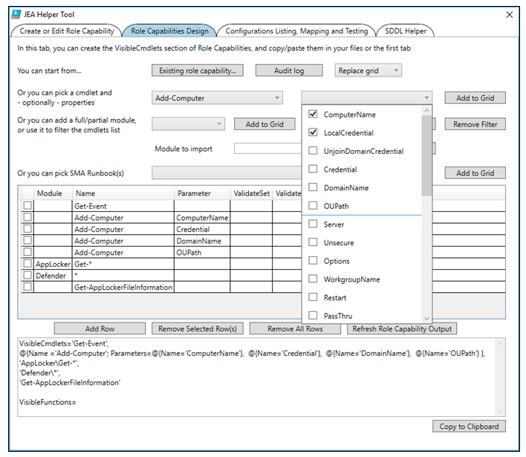
Professor Useful
JEA Helper Tool
Creates the configuration files for you
Notes:
GUI to help with creating and testing Role Capabilities and Session Configurations
Written in PowerShell, so you can look at the script underneath, to understand how it creates, maps, tests, registers, unregisters sessions on the local machine
Helping generate the “Security Descriptor Definition Language” (SDDL) syntax when you want to use Two-Factor Authentication
Ref: https://gallery.technet.microsoft.com/JEA-Helper-Tool-20-6f9c49dd

Slide 18
PowerShell logging
Use the right version: PowerShell v5
Over-the-Shoulder Transcription
Records information about the user, the virtual user, the commands run in the session, and more
Deep script block logging
PowerShell Event Logs
When turned on, all PowerShell actions are also recorded in regular Windows Event logs
Notes:
Some logging capabilities are available in version 4 too with KB 3000850.
To enable automatic transcription, enable the ‘Turn on PowerShell Transcription’ feature in Group Policy through Windows Components -> Administrative Templates -> Windows PowerShell. For automation, the configuration settings are stored under HKLM:\Software\Policies\Microsoft\Windows\PowerShell\Transcription.
A PowerShell “script block” is the base level of executable code in PowerShell. It might represent a command typed interactively in the PowerShell console, supplied through the command line (“PowerShell –Command <…>”), or wrapped in a function, script, workflow, or the like.
In addition to over-the-shoulder style transcription, PowerShell v5 and KB 3000850 introduces deep script block logging. When you enable script block logging, PowerShell records the content of all script blocks that it processes. If a script block uses dynamic code generation (i.e.: $command = “‘Hello World'”; Invoke-Expression $command), PowerShell will log the invocation of this generated script block as well. As with transcription support, this deep script block logging applies to any application that hosts the PowerShell engine – the command line shell, ISE, or custom host.To enable automatic transcription, enable the ‘Turn on PowerShell Script Block Logging’ feature in Group Policy through Windows Components -> Administrative Templates -> Windows PowerShell. For automation, the configuration settings are stored under HKLM:\Software\Policies\Microsoft\Windows\PowerShell\ScriptBlockLogging.
Ref: Practical PowerShell Security: Enable Auditing and Logging with DSC https://blogs.technet.microsoft.com/ashleymcglone/2017/03/29/practical-powershell-security-enable-auditing-and-logging-with-dsc
Ref: PowerShell ♥ the Blue Team https://blogs.msdn.microsoft.com/powershell/2015/06/09/powershell-the-blue-team/

Slide 19
Professor Useful
You can encrypt event logs
One concern when increasing the amount of logging on a system is the danger that logged content may contain sensitive data. For example, if you log the content of every PowerShell script that was run, there is the possibility that a script may contain credentials or other sensitive data.
If an attacker later compromises a machine that has logged this data, it may provide them with additional information with which to extend their reach.
Notes:
To prevent this dilemma, Windows 10 introduces Protected Event Logging. Protected Event Logging lets participating applications encrypt sensitive data as they write it to the event log. You can then decrypt and process these logs once you’ve moved them to a more secure and centralized log collector.
In Windows 10, PowerShell is the only application that participates in Protected Event Logging.
Protected Event Logging protects event log content through the IETF Cryptographic Message Syntax (CMS) standard. The CMS encryption standard implements public key cryptography, where the keys used to encrypt content (the public key) and the keys used to decrypt content (the private key) are separate.
To enable Protected Event Logging, enable the ‘Enable Protected Event Logging’ feature in Group Policy through Windows Components -> Administrative Templates -> Event Logging. This setting requires an encryption certificate, which you can provide in one of several forms:
The content of a base-64 encoded X.509 certificate (for example, as offered by the ‘Export’ option in Certificate Manager)
The thumbprint of a certificate that can be found in the Local Machine certificate store (usually deployed by PKI infrastructure)
The full path to a certificate (can be local, or a remote share)
The path to a directory containing a certificate or certificates (can be local, or a remote share)
The subject name of a certificate that can be found in the Local Machine certificate store (usually deployed by PKI infrastructure)
Ref: PowerShell ♥ the Blue Team https://blogs.msdn.microsoft.com/powershell/2015/06/09/powershell-the-blue-team/

Slide 20
.
Video
Video Placeholder
This slide has to be watched with PowerPoint
Notes:
During this video you can see:
An administrator connecting to Windows Admin Center and checking the properties of a server
An administrator uploading a file to a server
An administrator looking for an event in the event logs

Slide 21
Windows Admin Center
Windows Admin Center is a free tool to replace Microsoft Management Consoles
MMCs still work but are deprecated
Windows Admin Center is a web-based graphical remote administration console
Not yet a full replacement for the RSAT
It is missing roles such as Active Directory, DHCP, DNS, IIS
It can manage Windows Server 2012 and higher
It requires Windows Management Framework (WMF) version 5.1 or higher
MMC
Notes:
The former name of Windows Admin Center was Honolulu Project. It has been renamed Windows Admin Center once officially released. Some documentations still mention Honolulu and the actual name of the component on the server is called SME for Server Management Experience.
Windows Admin Center is complementary (for now) and does not replace RSAT (Remote Server Administration Tools) since roles such as Active Directory, DHCP, DNS, IIS do not have equivalent management capabilities in Windows Admin Center yet.
Windows Admin Center is supported on Edge, Chrome but not IE. It is also not tested on Mozilla Firefox, but most functionality should work.

Slide 22
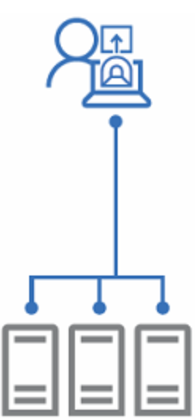
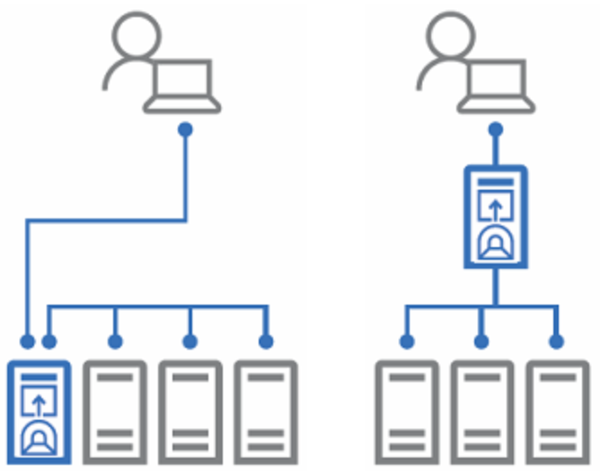
Types of installations
Desktop mode
Connect to the Windows Admin Center gateway from the same computer on which it's installed
Gateway mode
Connect to the Windows Admin Center gateway from a client browser on a different machine
Notes:
Desktop installation: Connect to the Windows Admin Center gateway from the same computer on which it's installed (i.e. https://localhost:[port])
Install on a local Windows 10 client that has connectivity to the managed servers. Great for quick start, testing, ad-hoc or small scale scenarios.
Gateway service: Connect to the Windows Admin Center gateway from a client browser on a different machine (i.e. https://servername)
Install directly on a managed server for the purpose of managing itself or a cluster in which it's a member node.Install on a designated gateway server and access from any client browser with connectivity to the gateway server.

Slide 23
On the wire
Desktop Mode
Gateway Mode
HTTPs
WinRM
HTTPs
WinRM
https://localhost:6516
https://server
Notes:
Desktop mode
When you install Windows Admin Center on Windows 10, it uses port 6516 by default, but you have the option to specify a different port. You can also create a desktop shortcut and let Windows Admin Center manage your TrustedHosts.
Modifying TrustedHosts is required in a workgroup environment, or when using local administrator credentials in a domain. If you choose to forego this setting, you must configure TrustedHosts manually.
WinRM is using the port TCP/5985 (TCP/5986 when using TLS).

Slide 24
Gateway access roles
Gateway users
They can connect to the Windows Admin Center gateway service in order to manage servers through that gateway, but they cannot change access permissions, nor the authentication mechanism used to authenticate to the gateway.
Gateway administrators
They can configure who gets access as well as how users will authenticate to the gateway.
Access to the console does not imply access to the managed servers
Notes:
Windows Admin Center defines two roles for access to the gateway service: gateway users and gateway administrators.
Gateway users can connect to the Windows Admin Center gateway service in order to manage servers through that gateway, but they cannot change access permissions nor the authentication mechanism used to authenticate to the gateway.
Gateway administrators can configure who gets access as well as how users will authenticate to the gateway.

Slide 25
Identity provider options
On-premises Active Directory Domain Services
Can use smartcard authentication
Azure Active Directory
Can use Azure AD Conditional Access Policies and multi-factor authentication
Requires to register the gateway as an enterprise application in Azure AD
Single-Sign On
It’s by design on desktop mode with Windows 10
It needs Kerberos delegation when installed in gateway mode
Notes:
The SSO in gateway mode uses Kerberos resource-based constraint delegation. Refer to the previous module for more information about Kerberos delegation.

Slide 26
Role-based access control
By default, the connected user needs to be a local administrator of the managed server
But you can enable RBAC and configure 3 roles:
Administrators - Full access to the target
Reader - Can only read, not change anything
Hyper-V Administrators - Can only change Hyper-V VMs settings when used with Hyper-V
Notes:
Role-based access control in Windows Admin Center works by configuring each managed server with a PowerShell Just Enough Administration endpoint. But the three roles are not customizable. So it’s a bit like an hardcoded JeA configuration.
Administrators
Allows users to use most of the features in Windows Admin Center without granting them access to Remote Desktop or PowerShell. This role is good for "jump server" scenarios where you want to limit the management entry points on a machine.
Readers
Allows users to view information and settings on the server, but not make changes.
Hyper-V Administrators
Allows users to make changes to Hyper-V virtual machines and switches, but limits other features to read-only access.
The following built-in extensions have reduced functionality when a user connects with limited access:
Files (no file upload or download)
PowerShell (unavailable)
Remote Desktop (unavailable)
Storage Replica (unavailable)
To assign users to roles, first select 'Apply' to enable the feature and create the appropriate groups (this can take up to 10 minutes – check here for updates). Then add the users to the corresponding group in Local Users and Groups.

Slide 27
SPA
Securing Privilege Access roadmap
Microsoft’s official guidance for using and protecting privileged accounts
It helps with…
Identifying the actions
Prioritization of the actions
Notes:
We have seen many mitigations and recommendations during this course. The SPA roadmap helps you to identify what to do first to address the more pressing security risks on one’s environment.
The next slides are taken from the online roadmap called: Securing Privilege Access.
Ref: http://aka.ms/privsec

Slide 28
How to protect your privileges against these attacks
Credential Theft & Abuse
Prevent Escalation
Three Stage Mitigation Plan
Prevent Lateral Traversal
2-4 weeks
1-3 months
6+ months
Increase Privilege Usage Visibility
DC Host Attacks
Harden DC configuration
Reduce DC Agent attack surface
AD Attacks
Assign Least Privilege
Attacker Stealth
Detect Attacks
Notes:
This slide maps out the types of attacks on privileges and the corresponding defenses. We divide this roadmap into three stages and prioritize the immediately impactful and quickest to deploy steps first.
Credential Theft and Credential Abuse – Stealing legitimate credentials and abusing them to gain access to data and systems
Prevent Escalation – Ensure that adversaries aren’t able to compromise computers in a higher tier by stealing credentials from a lower tier
Prevent Lateral Traversal – Ensure that adversaries cannot compromise other computers in the same tier by stealing and abusing credentials
Increase Privilege Usage and Visibility – Gain visibility into privilege usability to detect anomalous behavior and to discover unused/excessive privileges that have been assigned to personnel
DC Host Attacks – Attacking the Windows operating system on a domain controller to gain access to data and systems
Harden DC Configuration – Ensure that the configuration of the operating system doesn’t allow for unauthorized control of the DC (including Group Policy settings, where backups are stored, etc.)
Reduce DC Agent Attack Surface – Lower the amount of attack vectors to controlling the DC through management agents (which have effective full control of hosts they are installed on)
AD Attacks – Attacking the domain by using data or configurations in the active directory such as excessive administrative group memberships, weak access control lists, etc.
Assign Least Privilege – Mitigate these risks by identifying these configurations and correcting them.
Attacker Stealth – Attackers are able to conduct attacks, find vulnerabilities, and execute their mission (steal/alter/destroy data) undisturbed while they are undetected
Detect Attacks – Increasing detection allows defenders to find and disrupt attackers in the environment, preventing them from achieving their illicit objectives.
Note that we strongly suggest keeping to the recommended timelines because of the level of risk. We understand that these may be challenging for large enterprises to meet for full rollout but recommend at least starting projects within these time frames.
These attack methods are in active use in the wild and warrant an elevated sense of urgency beyond normal prioritization.

Slide 29


Protecting Active Directory and Admin privileges
2-4 weeks
1-3 months
6+ months
First response to the most frequently used attack techniques
3. Unique Local Admin Passwords for Workstations
4. Unique Local Admin Passwords for Servers
Active Directory
Azure Active Directory
1. Separate Admin account for admin tasks
2. Privileged Access Workstations (PAWs)
Phase 1 - Active Directory admins
Notes:
These are the steps to quickly mitigate the attack techniques most attackers try first.
1. Separate Admin account for admin tasks
Why: Separate internet risks (phishing attacks, web browsing) from domain administrative privileges
What: Create a dedicated account for all personnel with privileges (starting with domain administration, then server/app admins, then workstation/helpdesk admins)
How: Create new admin account, move all privilege assignments to admin account, use admin account for only privileged tasks
2. Privileged Access Workstations (PAWs)
Phase 1 - Active Directory admins
Why: Separate internet risks (phishing attacks, web browsing) from domain administrative privileges
What: Create a dedicated workstation for all personnel with privileges (starting with domain administration, then server/app admins, then workstation/helpdesk admins)
How: Follow guidance published at http://Aka.ms/CyberPAW
Microsoft Services solution: Privileged Access Workstation (PAW)
3. Unique Local Admin Passwords for Workstations
4. Unique Local Admin Passwords for Servers
Why: Adversaries can steal and re-use password hashes for local admin accounts to take control of machines with the same passwords
What: Configure unique (random) passwords on each workstation and register them in Active Directory
How: Install the Local Administrator Password Solution on workstation and servers from http://Aka.ms/LAPS
Microsoft Services solution: Proactive Operations Program - Securing Lateral Account Movement (POP SLAM)

Slide 30
First response to the most frequently used attack techniques
2-4 weeks
1-3 months
6+ months
Attack
Defense
Credential Theft & Abuse
Prevent Escalation
Top Priority Mitigations
Prevent Lateral Traversal
Increase Privilege Usage Visibility
DC Host Attacks
Harden DC configuration
Reduce DC Agent attack surface
AD Attacks
Assign Least Privilege
Attacker Stealth
Detect Attacks
Notes:
Note: The bars represent the relative effectiveness of the mitigations against currently known attack techniques. They do not represent a security guarantee or a measurement of your environment.
The mitigations in the 2-4 week plan are focused on (and will provide significant progress on) the top credential theft attack techniques that adversaries typically try first.
These are significant “quick wins” because of the high business impact of losing control of Active Directory on your on-premises and cloud assets.
You shouldn’t stop there because most determined adversaries will adapt and use other techniques to try and achieve their objective.

Slide 31



Protecting Active Directory and Admin privileges
2-4 weeks
6+ months
1-3 months
Build visibility and control of administrator activity, increase protection against typical follow-up attacks
6. Attack Detection
2. Time-bound privileges (no permanent admins)
3. Multi-factor for elevation
Active Directory
9872521
Azure Active Directory
1. Privileged Access Workstations (PAWs)
Phases 2 and 3 –All Admins and additional hardening (Credential Guard, RDP Restricted Admin, etc.)
4. Just Enough Admin (JEA) for DC Maintenance
5. Lower attack surface of Domain and DCs
7. Domain Controller Security Updates
Target full deployment within 7 days
Notes:
These capabilities will build on the mitigations from the 2-4 week plan and provide a broader spectrum of mitigations including increased visibility and control of administrative rights.
1. Workstations for all admins & Advanced Hardening
Why: Separate internet risks (phishing attacks, web browsing) from all administrative privileges
What: Create a dedicated workstation for all personnel with privileges (starting with domain administration, then server/app admins, then workstation/helpdesk admins)
How: Follow guidance published at http://Aka.ms/CyberPAW
Microsoft Services solution: Privileged Access Workstation (PAW)
2. Time-bound privileges (no permanent administrators)
Why: Lower Exposure of Privileges and Increase Visibility into privilege use by providing them to admins just in time (JIT)
What: Provide administrative rights on demand:
• For Active Directory Domain Services (AD DS), use Microsoft Identity Manager (MIM)’s Privileged Access Manager (PAM) capability
• For Azure Active Directory, use Azure Privileged Identity Management (PIM) capability
How: Follow guidance to install and configure (MIM PAM) or configure (Azure PIM) these capabilities
• http://aka.ms/PAM
• http://aka.ms/AzurePIM
Microsoft Services solution: Managed Access Request System (MARS)
3. Multi-factor for time-bound elevation
Why: Increase the assurance level of administrator authentication before granting privileges
What: Require Azure Multi-factor authentication (MFA) before administrative rights are granted to administrative accounts in AD (via MIM PAM) or Azure AD (via Azure PIM)
How: Configure requirement for MFA into privilege workflows using product documentation
• http://aka.ms/PAM
• http://aka.ms/AzurePIM
Microsoft Services solution: Managed Access Request System (MARS)
4. Just Enough Admin (JEA) for DC Maintenance
Why: Reduce quantity and risk exposure of accounts with domain administration privileges
What: Use Just Enough Administration (JEA) feature in PowerShell to perform maintenance operations on the domain controllers instead of accounts with full administrative rights on the DC (and domain)
How: Configure JEA feature on domain controllers using guidance at http://aka.ms/JEA
5. Lower attack surface of Domain and DCs
Why: Reduce opportunities for adversaries to take control of domains
What: Reduce known means of gaining control of DCs and AD Domains/Forests
How: Follow guidance to reduce this risk published at http://aka.ms/HardenAD to
• Remove Agents from DCs
• Remove Service Accounts from Domain Admin and equivalent groups
• Harden the remaining assets with control of DCs and domain (Virtualization Fabric, management tools, etc.)
Microsoft Services solution: Advanced Directory Services Hardening (ADSH)
6. Attack Detection
Why: Gain visibility into credential theft and other identity attacks
What: Deploy and configure Microsoft Advanced Threat Analytics (ATA)
How:
• Engage Microsoft Services to deploy ATA and help prepare you for detected incidents
Microsoft Services solution: ATA Implementation Services (ATAIS)
• Follow ATA deployment guide linked at http://aka.ms/ata
IMPORTANT: ATA is designed to detect an active adversary, so we strongly recommend engaging Microsoft services for an ATAIS engagement to ensure your team is prepared for this incident. This engagement integrates real world lessons learned from our incident response teams.
7. Domain Controller Security Updates
Why: Remove known vulnerabilities from Domain Controller attack surface. Microsoft has observed that many adversaries can exploit known unpatched vulnerabilities within days of the patch release. Updating these sensitive systems is critical, and updating all systems should also be a follow-on priority for the organization if not in place.
What: Deploy software updates to Domain Controllers for Windows Server and all installed tools/applications (Microsoft and 3rd party) within 7 days of release from vendor
How: Ensure software update processes and tools can accommodate required testing/piloting and full deployment within 7 days. Note that you can remove unneeded agents and software (step 5 of this phase) to lower the complexity of applying updates quickly. The technology to do software updates includes Windows Server Update Services (WSUS) or System Center Configuration Manager, and numerous 3rd party tools

Slide 32
Build visibility and control of admin activity
2-4 weeks
1-3 months
6+ months
Attack
Defense
Credential Theft & Abuse
Prevent Escalation
Prevent Lateral Traversal
Increase Privilege Usage Visibility
DC Host Attacks
Harden DC configuration
Reduce DC Agent attack surface
AD Attacks
Assign Least Privilege
Attacker Stealth
Detect Attacks
Notes:
The mitigations in the 1-3 month add broader set of mitigations for configuration and operational vulnerabilities that adversaries can exploit to gain full control of your environment. They also provide greater visibility into key administrative activities.
This will raise the bar and the cost for adversaries to attack active directory and administrative privileges over your on-premises and cloud assets.
You shouldn’t stop here because the return on investment (ROI) adversaries is extremely high for these type of attacks. Even with these mitigations in place, adversaries will likely persist in pursuing their goals and continue to invest to gain illicit access to your valuable business assets.

Slide 33
Protecting Active Directory and Admin privileges
2-4 weeks
6+ months
1-3 months
Move to proactive security posture
5. Shielded VMs for virtual DCs (Server 2016 Hyper-V Fabric)
1. Modernize Roles and Delegation Model
Active Directory
Azure Active Directory
2. Smartcard or Passport Authentication for all admins
3. Admin Forest for Active Directory administrators
4. Code Integrity Policy for DCs (Server 2016)
6. Apply Baseline Security Policies to DCs
Notes:
These capabilities will build on the mitigations from previous phases and move your defenses into a proactive posture. While there will never be perfect security, this represents the strong protections against privilege attacks currently known/available today.
1. Modernize Roles and Delegation Model (Consulting)
Why: Reduce Security Risk and operational friction
What: Redesign Roles and Delegation model to manage cloud privileges and capitalize on JIT/JEA capabilities
How: Engage Microsoft Services to scope an engagement that makes sense for your organization. Contact your account team or TAM for more information.
2. Smartcard or Passport Authentication for all admins
Why: Increase the assurance level and usability of administrator authentication
What: Require strong authentication for all admin accounts in your on-premises AD (including those federated for cloud services)
How: Follow guidance at
• Microsoft Passport - http://aka.ms/Passport
• Virtual Smartcards – http://www.microsoft.com/en-us/download/details.aspx?id=29076
• 3rd party multi-factor authentication
Note: This step is late in this roadmap revision (CY2016 Q1) because of deployment time for a PKI + Passport for on premises AD being unavailable at this time)
3. Admin Forest for domain administrators
Why: Provide the strongest protection for domain administrators with no security dependencies on the
What: The strongest protection for domain administrators can
How: Engage Microsoft Services to scope an Enhanced Security Administrative Environment (ESAE) engagement. Contact your account team or TAM for more information.
For an overview of the ESAE Admin Forest approach see pages 56-59 of the “Mitigating Pass-the-Hash and Other Credential Theft v2” available at http://www.microsoft.com/pth
4. Code Integrity Policy for DCs (Server 2016)
Why: Lock down your domain controllers so that only approved and signed applications and drivers can run on these machines.
What: Code Integrity for kernel (drivers) and user mode (applications) allows only authorized executables to run on the machine.
How: Create a code integrity policy based on a baseline domain controller machine. Sign the code integrity policy and apply the code integrity policy to all domain controllers
5. Shielded VMs for virtual DCs (Server 2016 Hyper-V Fabric)
Why: Protect virtualized domain controllers from attack vectors that exploit a virtual machine’s inherent loss of physical security
What: Use this new Server 2016 Hyper-V capability to prevent the theft of Active Directory secrets from Virtual DCs by fabric administrators and attackers/malware impersonating them. Generation 2 VMs using this feature can protect the data and state of a shielded VM against inspection, theft, and tampering.
How: Use Guarded fabric functionality per the guidance provided at: http://aka.ms/ShieldedVMs
6. Apply Baseline Security Policies to DCs
Why: Configurations that don’t match Microsoft recommendations can introduce significant security risks for the organization.
What: Ensure the Domain Controller configurations match the Microsoft recommended baseline configuration in the Microsoft
How: Apply the Microsoft Baselines for Domain Controllers.
For Windows Server 2012 R2 domain controllers, use the baselines in this download:
http://blogs.technet.com/b/secguide/archive/2014/08/13/security-baselines-for-windows-8-1-windows-server-2012-r2-and-internet-explorer-11-final.aspx
For Windows Server 2012 and prior, use the Security Compliance Manager (SCM) tool to download the baselines:
http://microsoft.com/scm
As with any production configuration change, Microsoft recommends testing the new configuration and ensuring you have a rollback plan in case of a compatibility issue.

Slide 34
Move to proactive security posture
2-4 weeks
1-3 months
6+ months
Attack
Defense
Credential Theft & Abuse
Prevent Escalation
Prevent Lateral Traversal
Increase Privilege Usage Visibility
DC Host Attacks
Harden DC configuration
Reduce DC Agent attack surface
AD Attacks
Assign Least Privilege
Attacker Stealth
Detect Attacks
Notes:
The mitigations in the 1-3 month add broader set of mitigations for configuration and operational vulnerabilities that adversaries can exploit to gain full control of your environment. They also provide greater visibility into key administrative activities.
This will significantly raise the cost for adversaries to attack active directory and administrative privileges over your on-premises and cloud assets.
Because adversaries are constantly evolving, you shouldn’t consider completion of this as the “end of the road”, but as a major milestone that is likely to change attacker behavior.
While we can’t perfectly predict the adversaries’ next move, the cost of compromising an admin may be so high at this point as to force them to shift tactics. They may start directly targeting users with access to sensitive data, target business sensitive systems directly, develop new types of attacks we haven’t yet seen.
Because of the potential variability, it is critical for your security team to stay in regular touch with security trends and the Microsoft team for current attack information.

Slide 36
List of abbreviations
RSAT Remote Server Administration Toolset
RDP Remote Desktop Protocol
JEA Just Enough Administration
RBAC Role-Based Access Control
MMC Microsoft Management Console
SPA Securing Privilege Access

